Slide 1

Software Development Project
Gonul Kilic
Edward Ai
Pooja Khare
Surabhi Trivedi

Slide 2


Problem Definition
To replace the google forms with the database backed web application which solves the purpose of google forms as well as manages the employees data and the maintenance of the buildings.

Slide 3
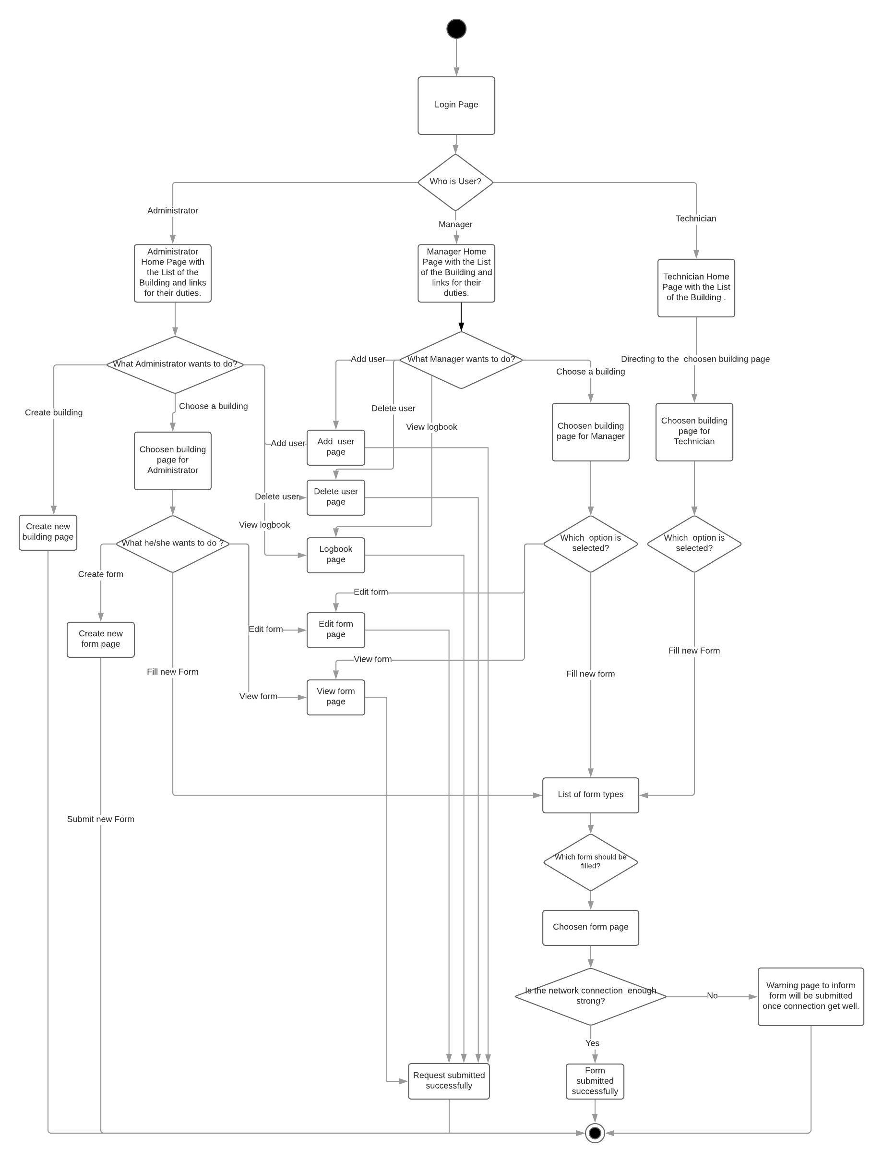
Workflow

Slide 4
Software Solution
HTML, PHP, JavaScript and MySQL to develop our web application
HTML for login page
PHP for dynamic HTML page
JavaScript for testing input
Integrated JSON for data manipulation
Dynamic form
Elements name
Packed in JSON
JUnit Testing (HtmlUnit-2.35.0)
External JAR files
Tested each page’s elements
XAMPP
Apache Web Server
MySQL Database Server

Slide 5

What Users Can Do ?
Administrator: add building, Add user, add a new form types, fill form, delete form, edit form, view data.
Manager: Add user, fill form, delete form, edit form, view form.
Technician: view form, fill form.

Slide 6
LEARNING
Great team building exercise.
Hands on experience on website development.
Collaborative sharing of code using Github.
Implementation of Unit Testing.

Slide 7
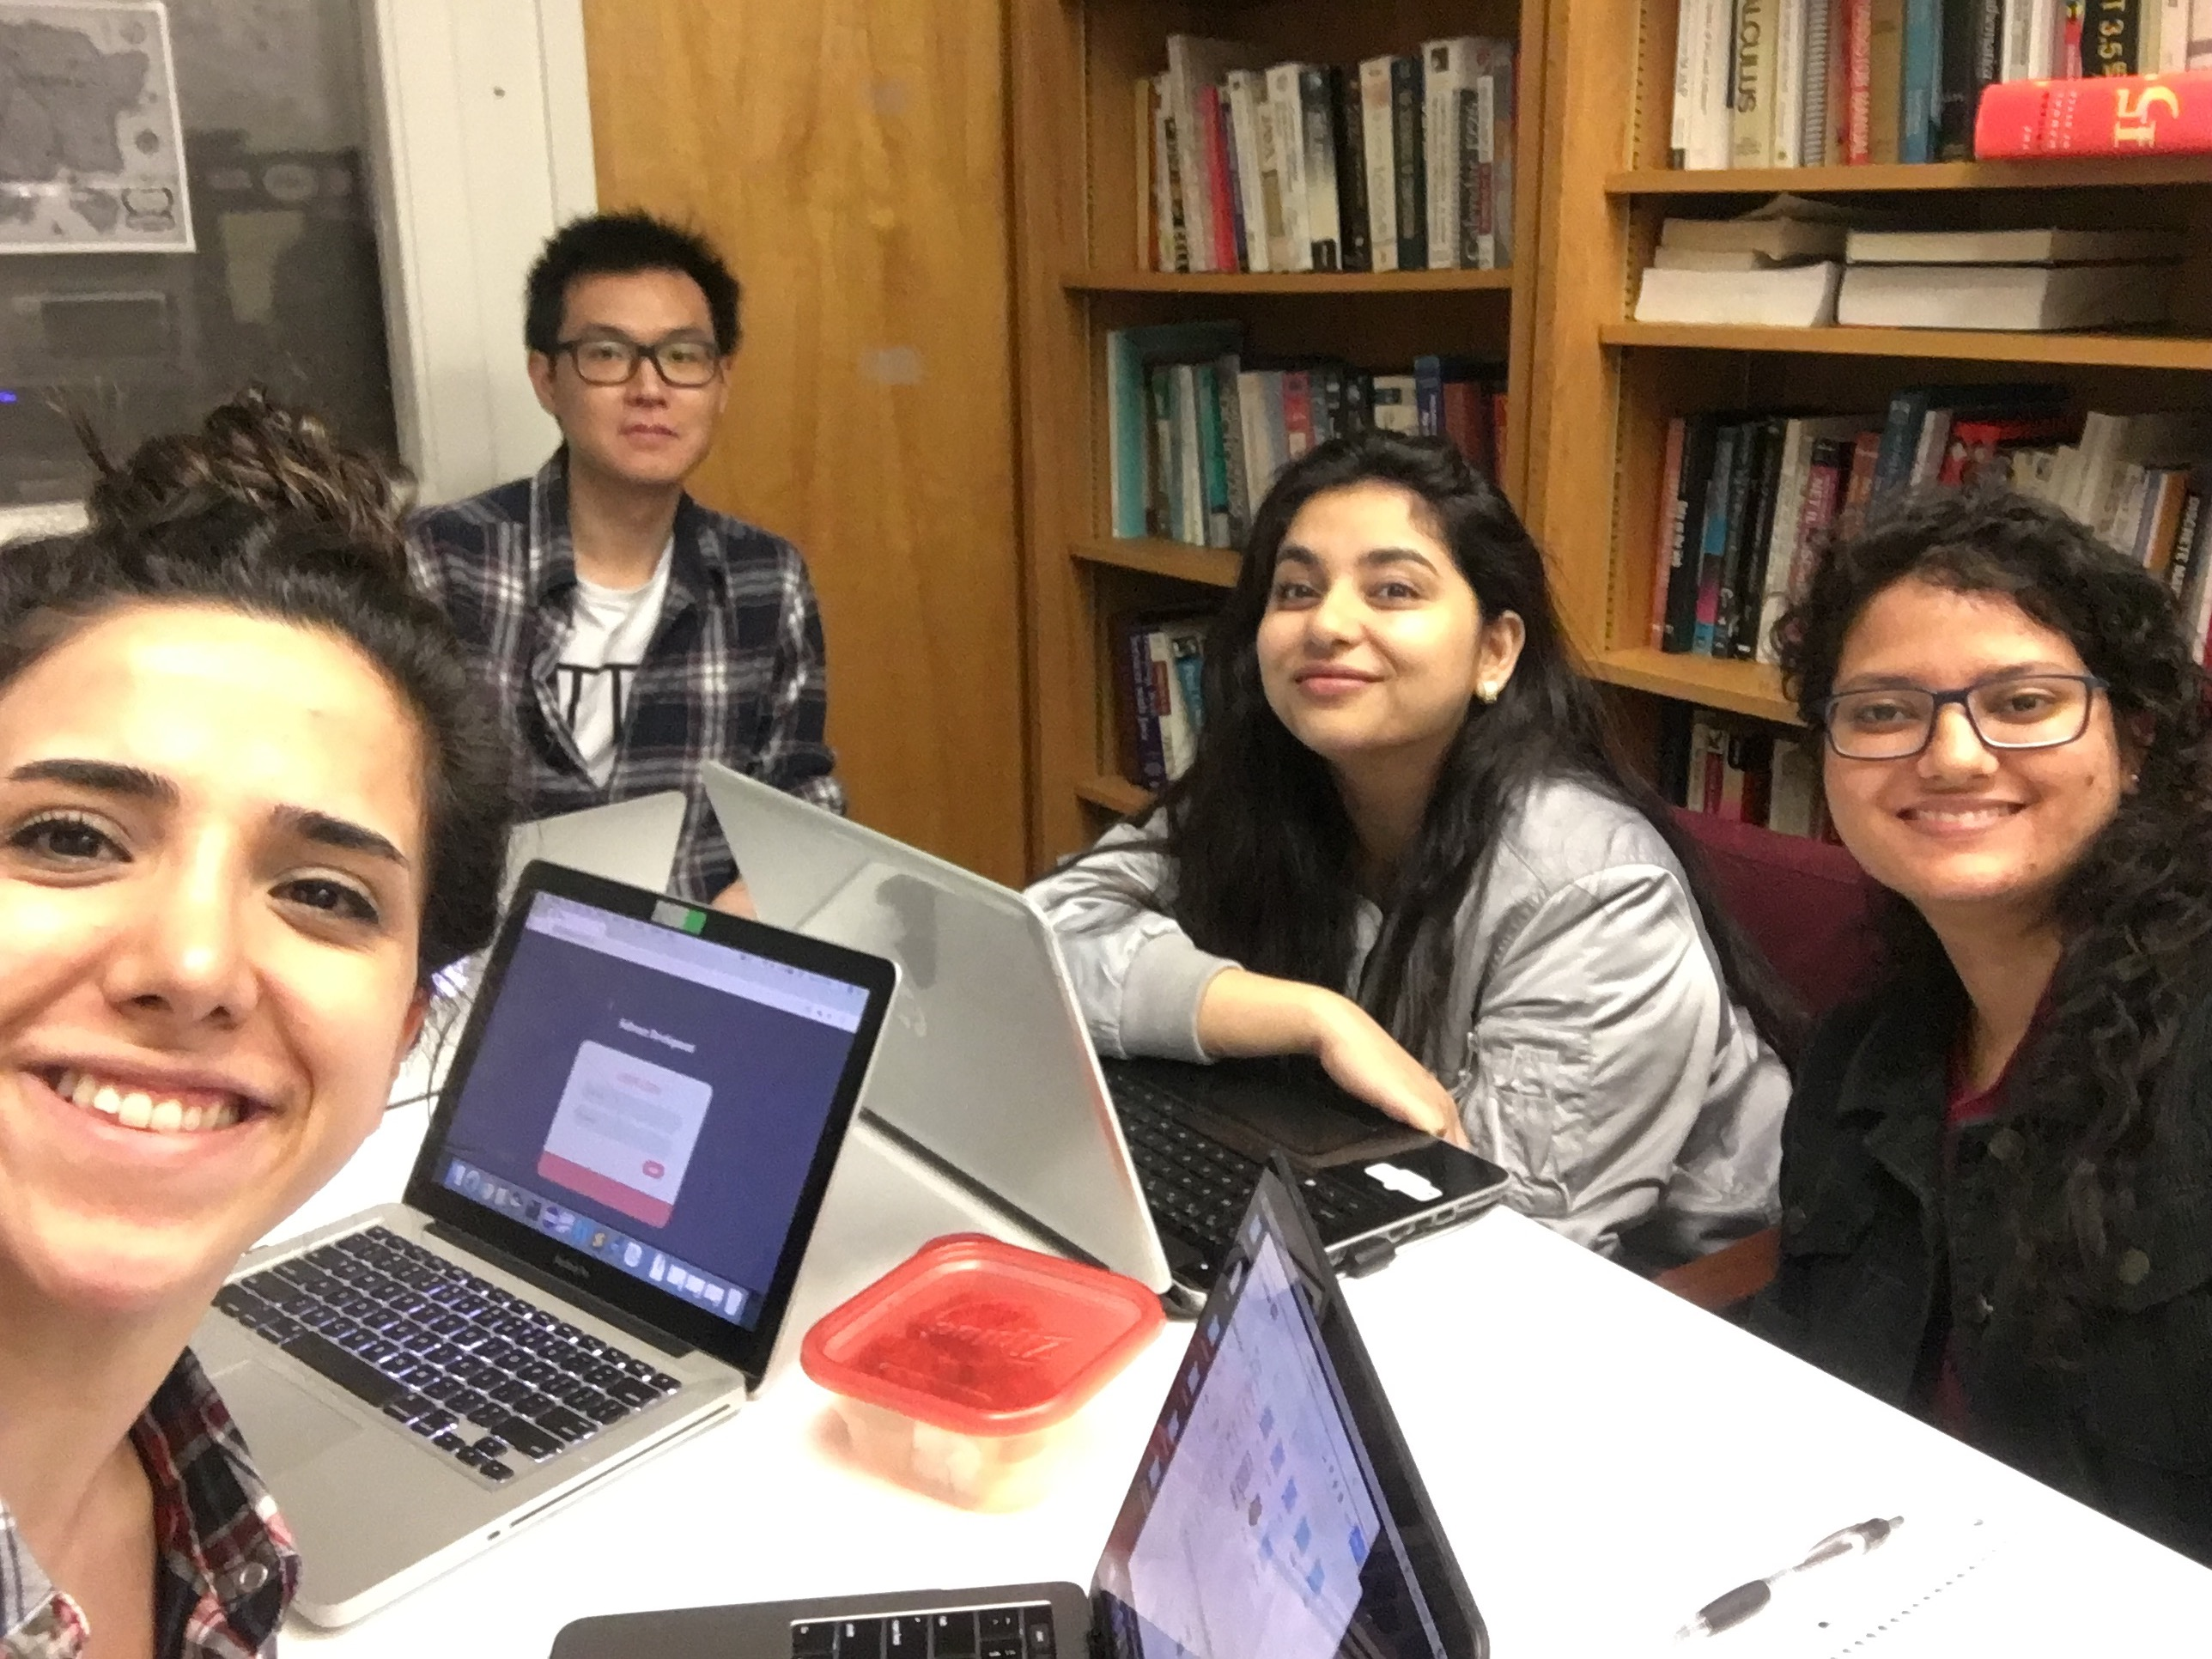
THANK YOU FOR LISTENING US !

